Slide 1
Visual Analytics of
Documents and Texts
JOUR479V/779V – Computational Journalism
University of Maryland, College Park
Nick Diakopoulos, Ph.D.

Slide 2
Definitions
Visual Analytics
The science of analytical reasoning facilitated by interactive visual interfaces.
Integrates automated data analysis techniques with appropriate visualization and interaction techniques for humans to cope with scale

Slide 3
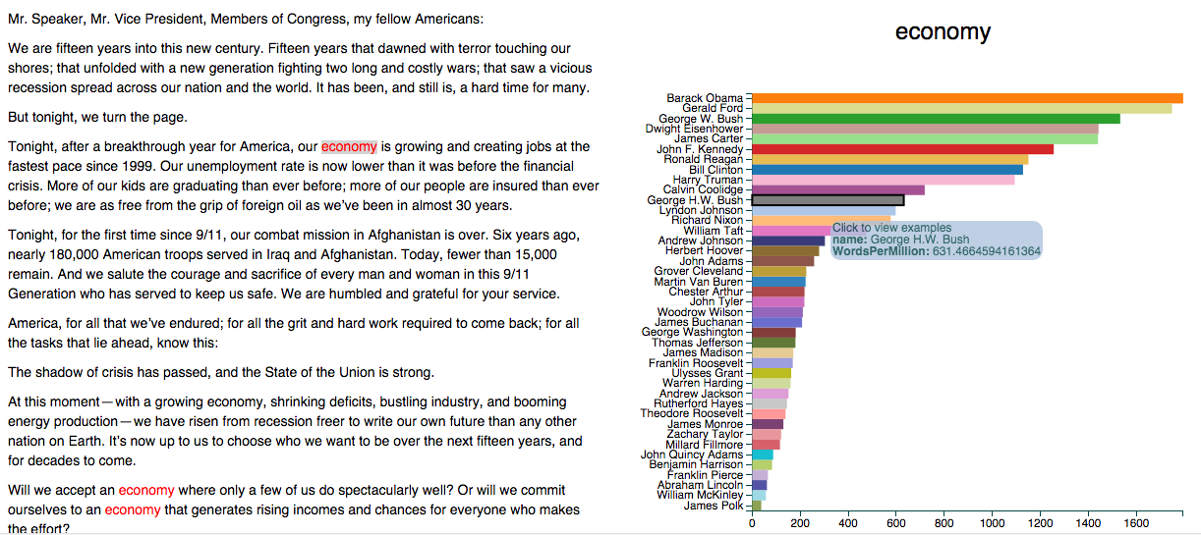
Counts + Comparison
http://benschmidt.org/poli/2015-SOTU
Notes:
http://benschmidt.org/poli/2015-SOTU?utm_campaign=Data_Elixir_20&utm_medium=email&utm_source=Data%2BElixir
Allows you to click a word in the SOTU and compare the rate of use of that word to all other president’s SOTU addresses.

Slide 4
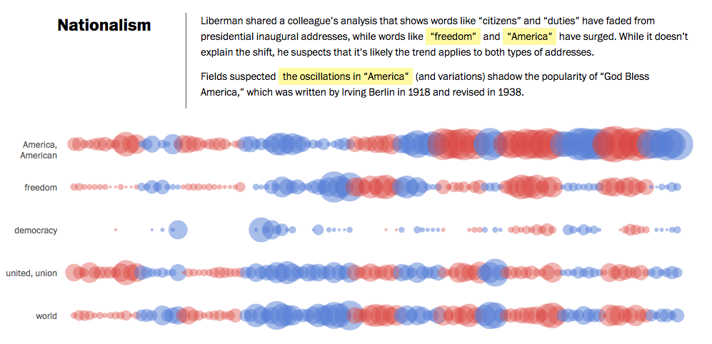
Counts Over Time + Semantics
http://www.washingtonpost.com/wp-srv/special/politics/2014-state-of-the-union/language-of-sotu/
Notes:
http://www.washingtonpost.com/wp-srv/special/politics/2014-state-of-the-union/language-of-sotu/
Counts over time, with semantic dimension (party). Plus storytelling and directing your attention
In the middle of exploratory and explanatory you have an example this this from the Washington Post (Kennedy Elliot and collaborators). It not only shows word use over time, but also color codes according the political affilitation, and draws out specific observations in this case about keywords relating to nationalism, but also foreign policy, economy, and other issues. So it directs your attention toward interesting observations, but also allows for some self directed exploration

Slide 5
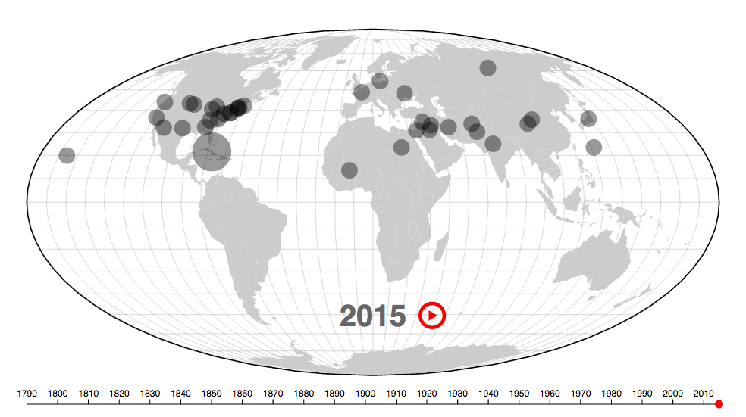
Counts + Maps
http://www.theatlantic.com/features/archive/2015/01/mapping-the-state-of-the-union/384576/
Notes:
http://www.theatlantic.com/features/archive/2015/01/mapping-the-state-of-the-union/384576/
Or this Atlantic piece which extracts the location names mentioned in SOTU over time and plots them in an animated map over time.

Slide 6
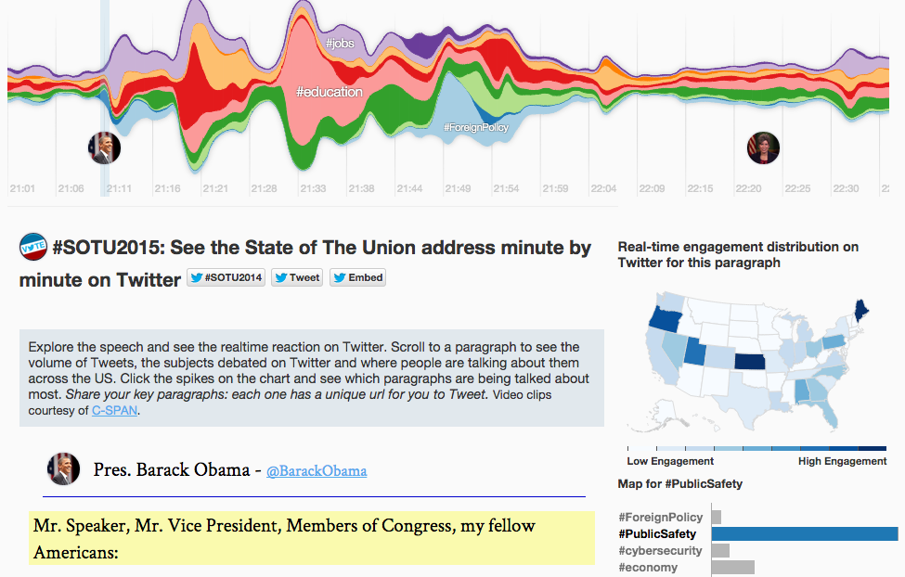
http://twitter.github.io/interactive/sotu2015/#p1
Notes:
Based on the original work called Themeriver- idea is to show how different topics or in this case hashtags evolve over time. Notice how they combine several data scheme in one dashboard (time, geography, and count)

Slide 7
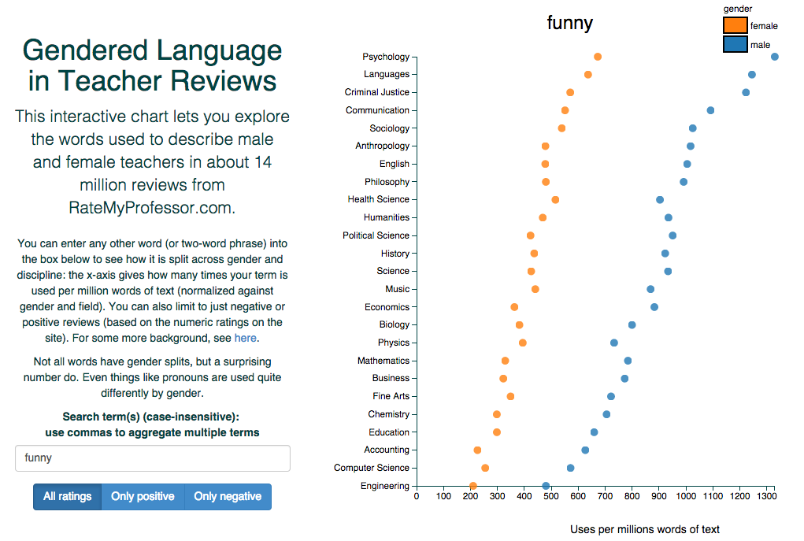
http://benschmidt.org/profGender/
Notes:
And of course there are applications outside of politics here. Including this piece by benschmidt comparing the use of words in different disciplines from reviews on ratemy professor.com
There are many many stories waiting to be told, and visualized from text corpora. Twitter, Yelp, Movie reviews, Online comments, News articles, Politicians quotes, government records and documents.

Slide 8
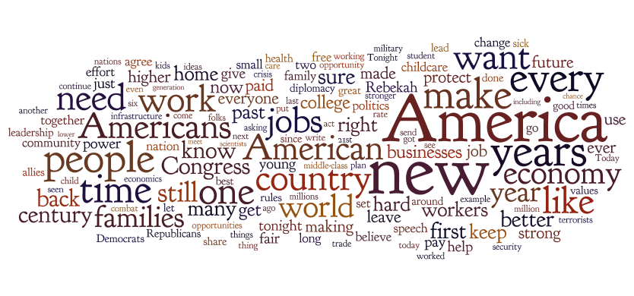
Wordles
http://www.wordle.net/create
Notes:
A fun way to get across the gist of a bunch of text, it’s counting up the frequency and mapping that to font size, font weight, color, or intensity, then running a space packing algorithm to try to get everything to fit together nicely.
As a result, the position of the words isn’t meaningful (neither are the colors in this case). And you can see issues with something we’ll visit later called “stemming” since you have the same word “americans” “american” and “america” appearing 3 times in slight variations. At the same time, it does give a very coarse and easy entry point.

Slide 9
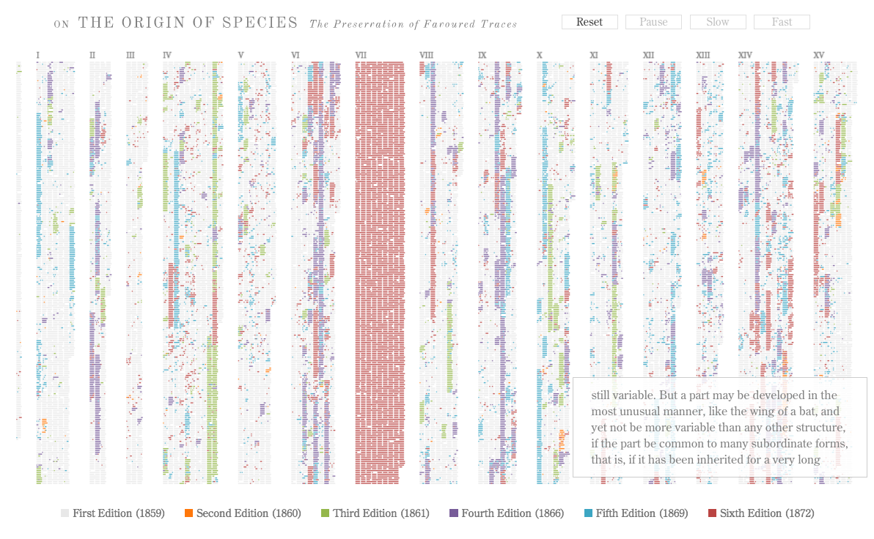
Structure
http://benfry.com/traces/
Notes:
This of course deserves a much higher resolution display than we have, but perhaps you can get the gist of what this is showing. A project from Ben Fry (creator of processing) It is actually animated online and you should take a look there. But what it shows is the evolution of new chunks of text being added to subsequent editions of “On the origin of species” by charles darwin.
It gives a great overview, but also shows you where the new material is added over time and distributed through the volumes of the work. An evolution.

Slide 10
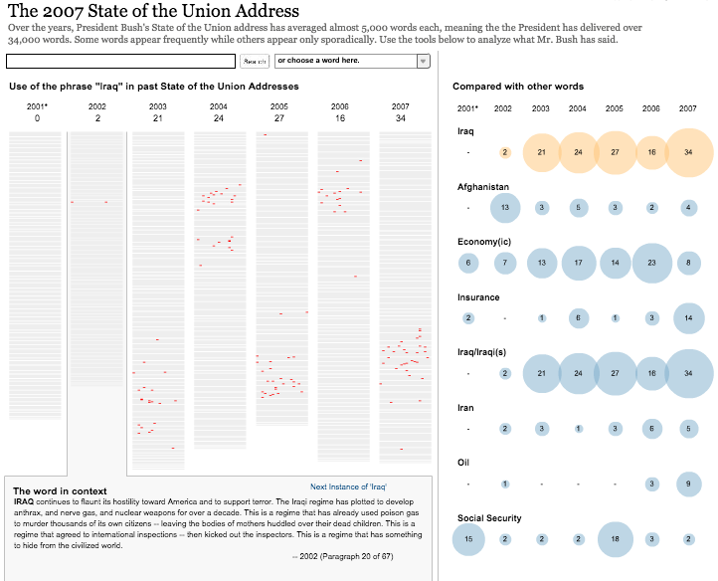
http://www.nytimes.com/ref/washington/20070123_STATEOFUNION.html?initialWord=iraq
Notes:
And you also see this technique being used in news visualizations, this one from the NYT, which shows the position of the use of various words within the SOTU’s of George Bush. Allowing you to search and see structurally where such terms were used. This is layered in with the display at right, which shows a bubble chart of the volume of use over time, to draw your attention to key terms being used.
This also allows for some comparison, at least to a point.

Slide 11
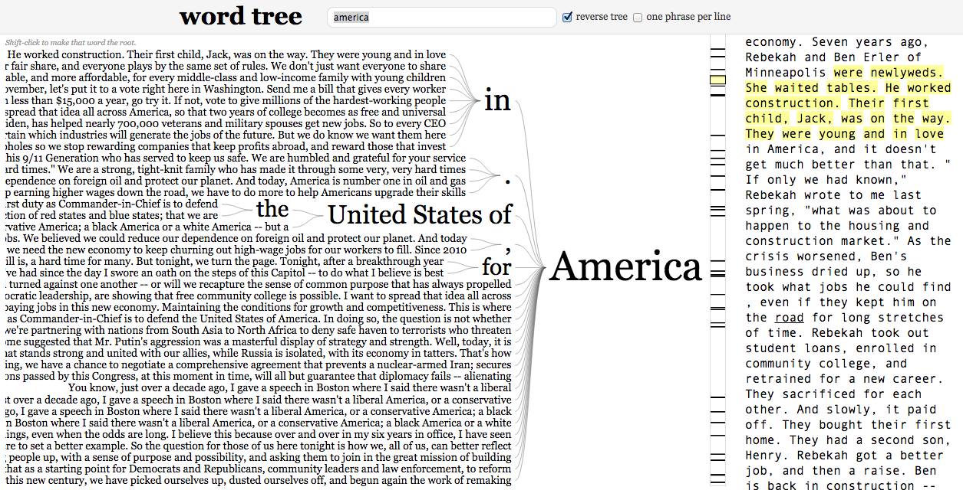
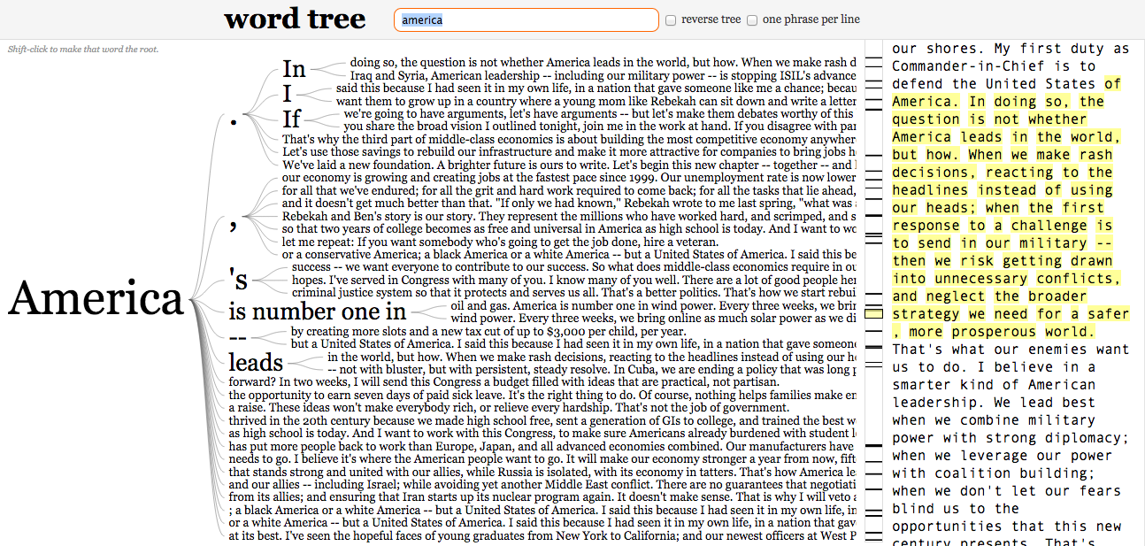
Word Tree
http://www.jasondavies.com/wordtree
Notes:
So you also have things like word trees, which try to walk this line of showing you frequency and structure. In this case we see this years SOTU with “america” at the root. And we can see a few of the similar phrases that were built around that root term.

Slide 12
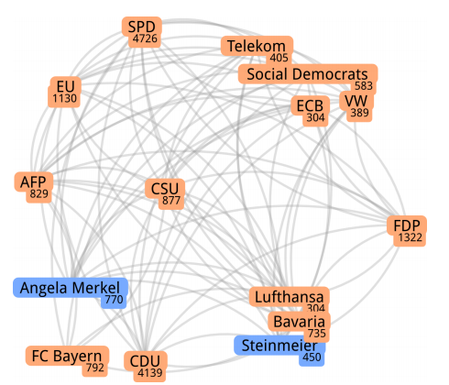
Networks
Networks of Names: Visual Exploration and Semi-Automatic: Tagging of Social Networks from Newspaper Articles. EuroVis 2014.
Notes:
From german news paper articles. Vertices are people or organizations that are extracted and counted automatically, Edges are binary relationships reflecting their appearance in the same sentence.

Slide 13
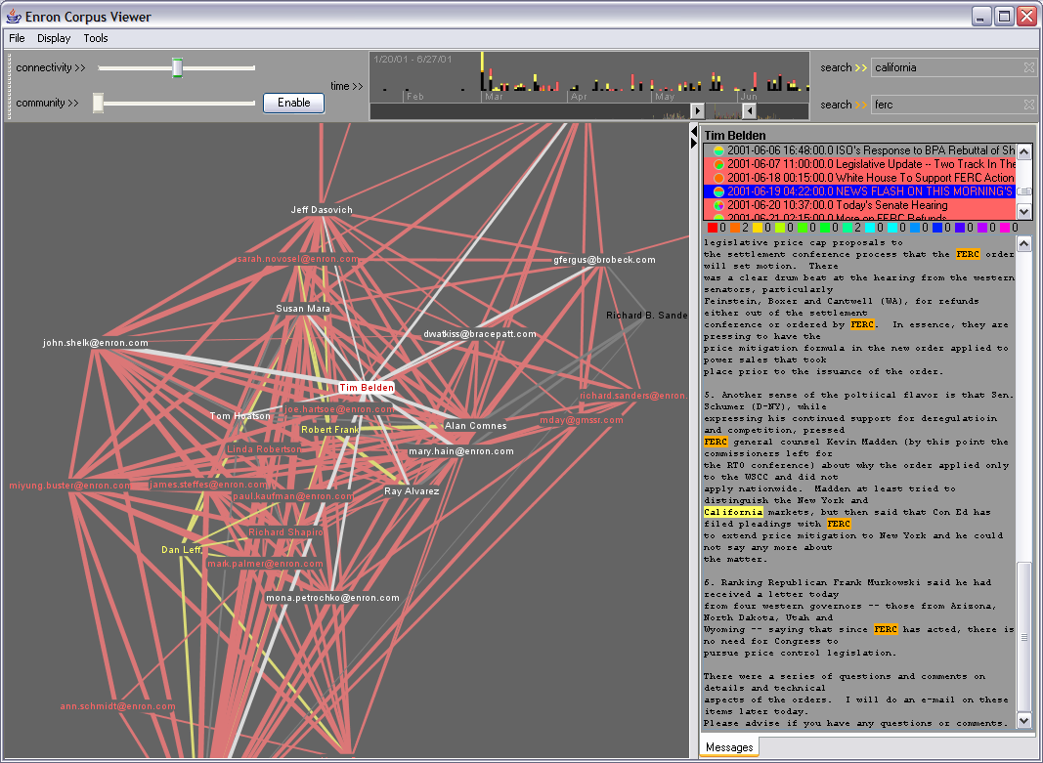
Notes:
Why do we want to visualize using networks? Can see relationships in communication … e.g. in this Enron corpus of emails you can see who was responding to whom

Slide 14
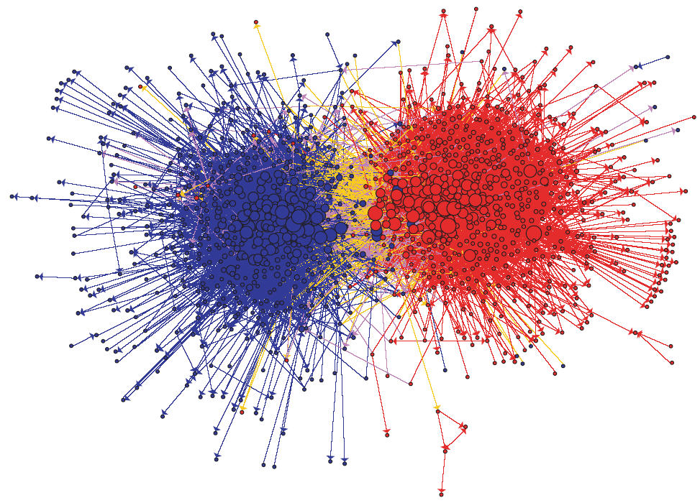
Notes:
Networks can also be useful for understanding social media linking patterns. E.g. Political blogging – who links to whom?
Political blogosphere shows the hairball issue … at least you can still see the major clusters, which is probably the important story here, but you still miss any nuance within those groupings.

Slide 15
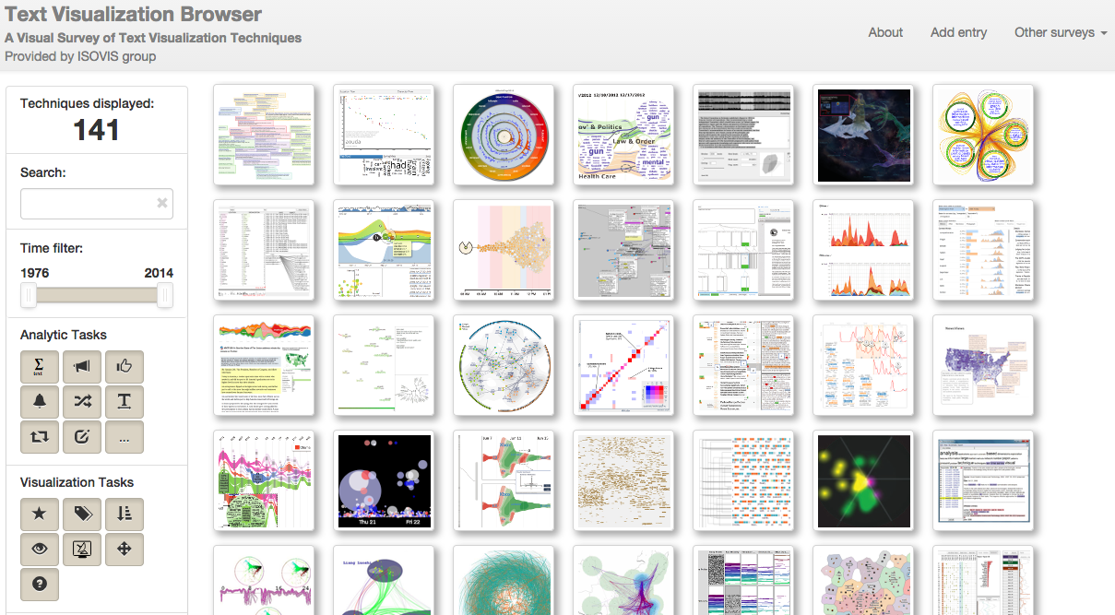
http://textvis.lnu.se/
Notes:
And if you’re lacking for inspiration check out the Text visualization browser which has 141 different text vis techniques which cover different data sources, analytic tasks, domains, visual scheme

Slide 16
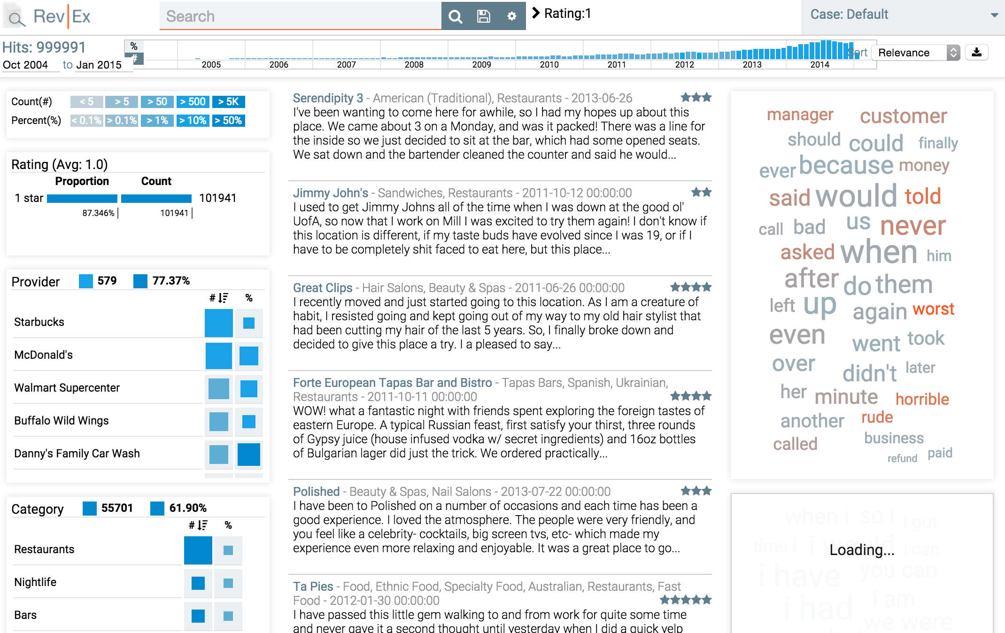
Readings
RevEx: Visual Investigative Journalism with a Million Healthcare reviews
http://nyuvis.github.io/revex
Notes:
Quick demo on a diff dataset. Right rail are suggested keywords that are surfaced from the current results set.

Slide 17
Investigative Exploration
Although Yelp’s health reviews date back to 2004, more than half of them were written in the past two years
Providers with the highest number of reviews generally have poorer ratings
Negative reviews are very often due to problems with customer service and staff behavior
Search for key terms like “HIPAA”
Specific cases: Western Dental's average rating of 1.8 stars on Yelp is well below the average of 4 for all dentists nationwide. About 1,250 of its 3,000 reviews used the words "wait" or "waiting" and about 15 percent of them, the word "worst."
http://www.npr.org/sections/health-shots/2015/08/06/429624187/on-yelp-doctors-get-reviewed-like-restaurants-and-it-rankles
Notes:
End story doesn’t even necessarily have to be visual, but visualization helps you get the insights that drive the story.

Slide 18
Readings
RevEx: Visual Investigative Journalism with a Million Healthcare reviews
For what other datasets might a tool like RevEx be useful journalistically, e.g. for finding story ledes?
How do you think such a tool would influence a journalistic investigation?
Notes:
Goal of looking at reviews is to find patterns in the anecdotes of the individual review.
Depending on what terms are suggested this could orient journalistic attention.

Slide 19
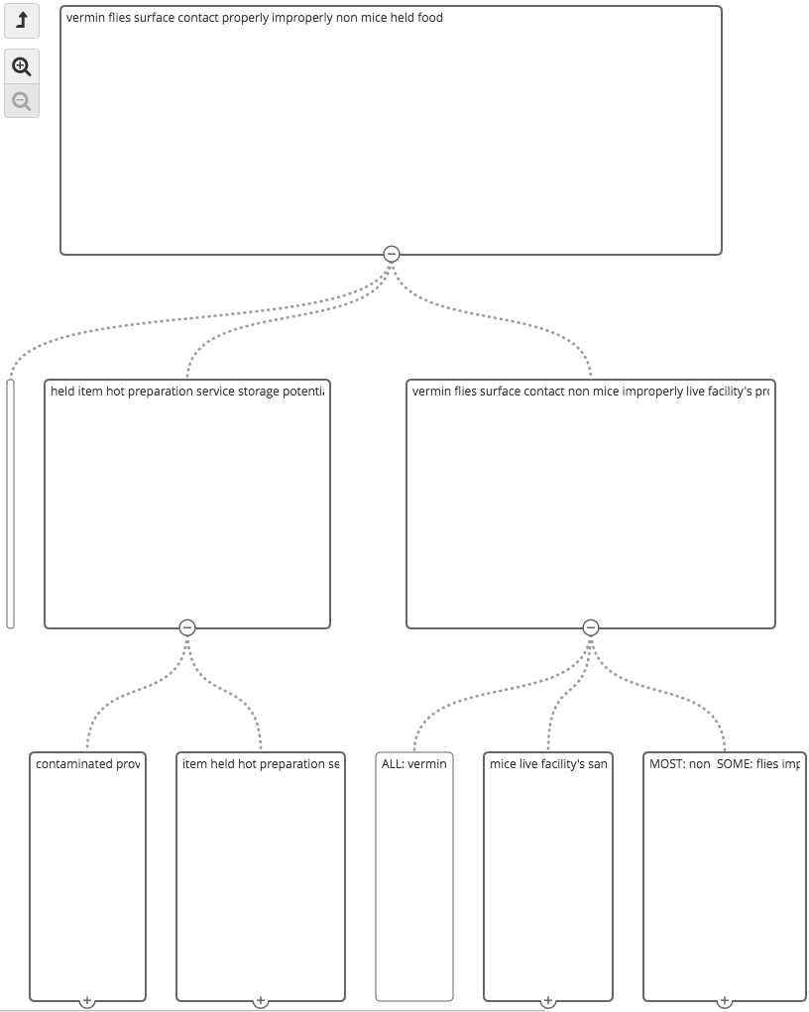
Readings
Overview: visual document mining tool for investigative journalists
Let’s look at a demo: https://www.overviewdocs.com
Notes:
Exploration as a mode of search where you know neither the location or identity of the target.
Often times they’re not explore - In many cases they have a hypothesis in mind and are looking for evidence of it, or to confirm that there’s NO evidence of it.

Slide 20
Readings
Overview: visual document mining tool for investigative journalists
How do journalists use such a tool to “explore”? Compare that to use of a tool of verify.
Why is it important to study the adoption of such tools?
Notes:
Exploration as a mode of search where you know neither the location or identity of the target.
Often times they’re not explore - In many cases they have a hypothesis in mind and are looking for evidence of it, or to confirm that there’s NO evidence of it.
Study of adoption: can be hard to know if it fits with workflow, does it really work? Can iterate and improve it as you gather feedback about adoption / non-adoption

Slide 21


